Slide 1
Project D Cyber Security Analyst
By Shahed Alam

Slide 2
Presentation Content
Robot Parts Inc’s task
Tools
Pfsense
Snort
Rules
Logs
Alerts
Access and security
Recommendations

Slide 3
Robot Parts Inc Task
Improve their security
Identify and log attacks

Slide 4
Systems that will be used
Pfsense- It is a operating system for firewalls and routers. It is used because of continuous updates and fixing patches. It is based on FreeBSD
Snort- is a system used for detecting and preventing intruders in the network

Slide 5
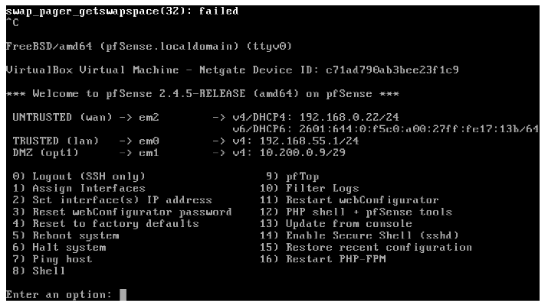
Pfsense fireWall
Untrusted wan: 192.168.0.22
Trusted lan: 192.168.55.1
DMZ: 10.200.0.9

Slide 6
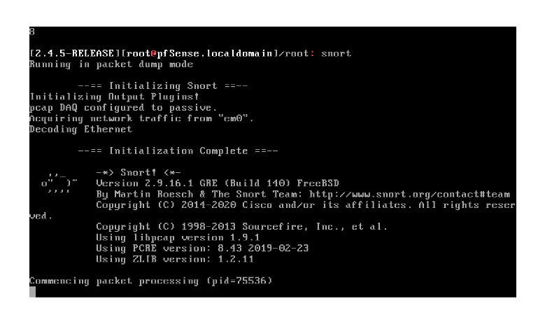
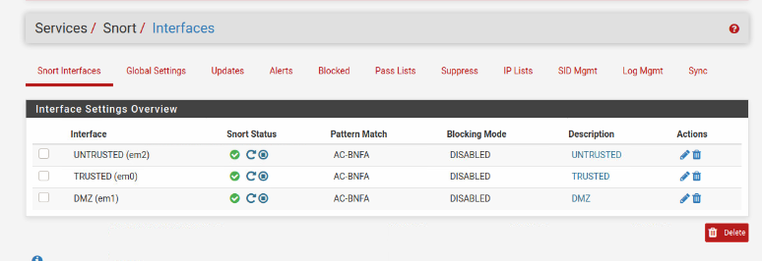
Snort

Slide 7

RULEs
Firewalls have rules in order to allow certain traffic and block unwanted traffic. An order of rules is important because it blocks packets that do not match the rules
A rule that would allow only HTTP traffic into the DMZ:
Allow only TCP payload from anywhere -> destination 443. Port 443 is for secured HTTP traffic.
A rule that would block FTP traffic from untrusted source:
-Untrusted source with TCP payload heading toward -> port 21- Port 21 is for File Transfer Protocol

Slide 8
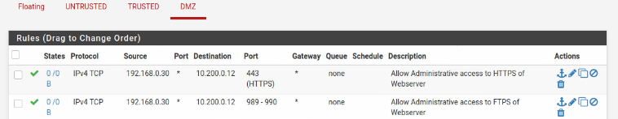
192.168.0.30 Rule
Port 443: HTTPS
Port 989-990: FTPS

Slide 9



Network Topology
Trusted-NW
192.168.55.1
Router-Pfsense FW
192.168.0.26
Untrusted Network
192.168.0.25
CEO PC
Kali_linux
Production Server
Kali-linux
DNS Sever
Web Server
DMZ
10.200.0.9

Slide 10
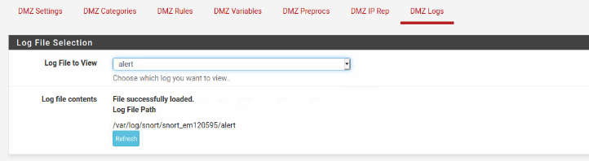
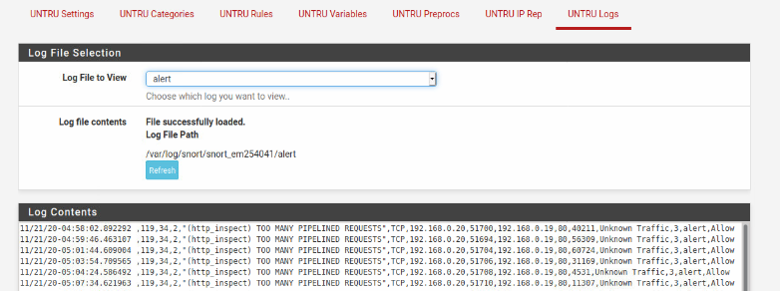
Logs
The logs that would be useful monitoring the traffic would the ones that would show and block suspicious traffic or attacks. Using pfsense, the user can see what has been recorded to further improve security if needed.

Slide 11
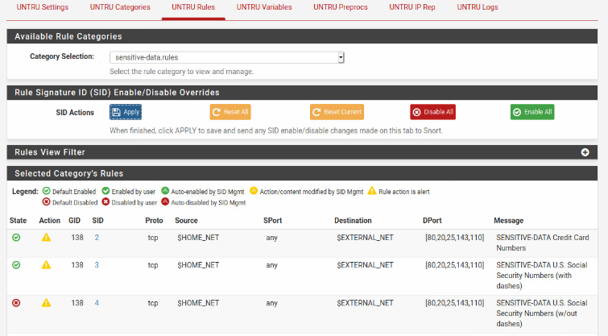
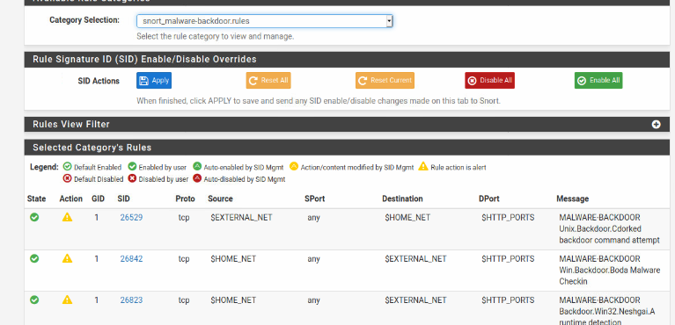
ALerts
Untrusted Network
alert icmp any any -> any any (msg:"ICMP test"; sid:1000001;rev:1; classtype: icmp-event;)
alert tcp any any -> 192.168.0.26
21 (msg:"FTP connection attempt"; sid:100002; rev:1;)
DMZ Network
alert icmp any any -> any any (msg:"ICMP test"; sid:1000001;rev:1; classtype: icmp-event;)
alert tcp any any -> 10.200.0.9 21 (msg:"FTP connection attempt"; sid:100002; rev:1;)

Slide 12
Access and transfer security
Inappropriate websites can be blocked by:
Enter websites under a blacklist
Create an alias with websites IP in firewall
Secure file transfer:
Set up the trusted and DMZ interface with a qDefault and qLocal queue. This will allow traffic from one network to another to be put into the qLocal queue, while other different traffic goes to qDefault queue. Qlocal queue has low priority on harmless traffice, so filtering the traffic will be much safer.

Slide 13
Recommendations
Improving security:
Implement a network firewall with a secure application layer protection that should can inspect the content of traffic and block malicious requests such as SQL injection attacks.
3 commercial IDS/IPS Products:
Snort- it has three modes which are packet sniffer mode, packet logger, and intrusion detection
Suricata-Uses signature based and policy drive intrusion methods
Zeek-Uses traffic logging and analysis and track services from different OSI layers.

Slide 14
Questions
1. Refer to Slide 7
2. Refer to Slide 7
3. Refer to Slide 7
4. Refer to slide 4
5. Refer to slide 10
6. Refer to slide 12
7. Refer to slide 12
8. Refer to slide 8
9.Refer to slide 13
10. Refer to slide 13

